Slide 1
CONSUMERISM vs. COMPASSION:
Challenging the Globalization of Indifference
ADULT CATHOLIC EDUCATION
Michael H. Crosby, OFMCap.
St. Michael’s Church / Independence, Ohio
March 22, 2017

Slide 2
THE NEED FOR A NEW CONSCIOUSNESS
A human being is part of the whole called by us universe, a part limited in time and space. We exper-ience ourselves, our thoughts and feelings as some-thing separate from the rest. A kind of optical delusion of consciousness. This delusion is a kind of prison for us, restricting us to our personal desires and to affection for a few persons nearest to us.
Our task must be to free ourselves from the prison by widening our circle of compassion to embrace all living creatures and the whole of nature in its beau-ty. We shall require a substantially new manner of thinking if humankind is to survive. Albert Einstein 02.12.50

Slide 3
MOVING FROM NEWTON TO QUANTUM
Instead of a mechanistic worldview flowing from Newtonian physics, “quantum theory has abolished the notion of fundamentally separated objects. [It] has introduced the concept of the participator to replace that of the observer, and may even find it necessary include human consciousness in its des-cription of the world. It has come to see the uni-verse as an interconnected web of physical and mental relations where parts are only defined through their connections to the whole.”
Fritjof Capra, The Tau of Physics (Berkeley, CA: Shambala, 1975), 142.

Slide 4
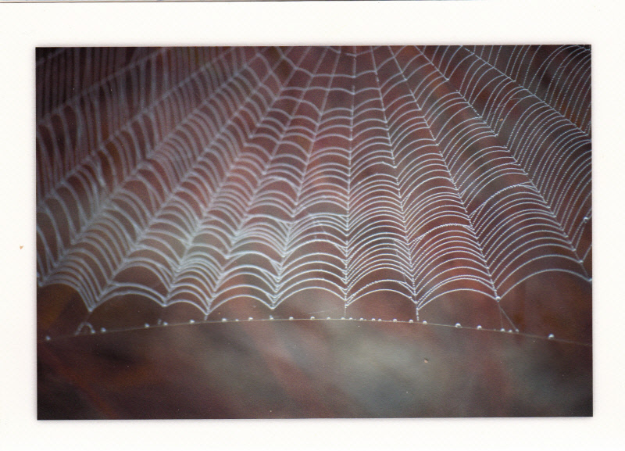
“We Are All Linked,” Fe Langdon Designs
OUR LIVES: A WEB OF RELATIONSHIPS

Slide 5
THE MOST REDEMPTIVE POWER IN THE UNIVERSE IS THE POWER OF COMPASSION. IT IS THE GOAL OF ALL HUMAN RELATIONSHIPS.
WHAT HAPPENS IF COMPASSION IS ELIMINATED BY INDIFFERENCE?

Slide 6
“Some people assume that economic growth, encouraged by a free market, will inevitably bring about greater justice and inclusiveness in the world. This opinion, which has never been confirmed by the facts, expresses a naïve trust in the goodness of those wielding economic power and in the sacralized workings of the prevailing economic system. Meanwhile, the excluded are still waiting. To sustain a lifestyle which excludes others a globalization of indifference has developed. Almost without being aware of it, we end up being incapable of feeling compassion at the outcry of the poor, weeping for other people’s pain, and feeling a need to help them, as though all this were someone else’s responsibility and not our own. The culture of prosperity deadens us; we are thrilled if the market offers us something new to purchase. In the meantime all those lives stunted for lack of opportunity seem a mere spectacle; they fail to move us.” Pope Francis, Evangelii Gaudium, 54.

Slide 7
INDIFFERENCE: COMPASSION’S GREAT OBSTACLE
“To the indifferent eye, nothing calls or awakens. Indiffer-ence is one of the hallmarks of our times. It is said that indifference is necessary for power; to hold control one has to be successfully indifferent to the needs and vulner-abilities of those under control. Thus indifference calls for a great commitment to nonvision. To ignore things demands incredible mental energy. Without even knowing it, indifference can place you beyond the frontiers of com-passion, healing, and love. When you become indifferent, you give all your power away. Your imagination becomes fixated in the limbo of cynicism and despair.” John O’Donohue, Anam Cara, 64.

Slide 8
POWER =
“I AM”
Thinking
Feeling
Acting

Slide 9
Power is “the ability to influence”
POWER =
“I AM”
Thinking
Feeling
Acting
Power is about Relationships

Slide 10
CARE
Correction
Challenge
Affirmation
Respect
POSITIVE WAYS OF RELATING
+ FORCE / ENERGY
Power is “the ability to influence”
POWER =
“I AM”
Thinking
Feeling
Acting
NEGATIVE WAYS OF RELATING
Power is about Relationships
- FORCE / ENERGY
Coercion
Exploitation
Manipulation
Domination
CONTROL

Slide 11
POWER AS COERCION
The dynamics of a group (pressure) or more powerful entity effectively deny the freedom to disagree or dissent to another.
Adolescence and the “need to belong.”
Effectively such dynamics “dis” a person (= disrespect or disregard what the persons thinks, feels, etc.
When the group’s coercive power dominates the ultimate moral authority of a person’s informed conscience is jeopardized.

Slide 12
POWER AS EXPLOITATION
The act of using something or someone for any purpose.
Forcing someone to act against his/her conscience
The act of using something or someone in an unjust or cruel manner for the benefit of some at the expense of others; the benefit of a few at the expense of the many.
The objectification of human beings; using people (persons) as a resource (things); human exploita-tion.
Arbitrary and/or abusive use of power in various kinds of relationships.

Slide 13
POWER AS MANIPULATION
Ways We Try to Get Our Needs/Wants Met
Mental manipulation: withholding facts or a fuller truth from another to fulfill something desired.
Emotional manipulation: used when honesty will not work. The use of guilt. How emotional manipulators influence the environment around them.
Covert Aggression vs. Covert-Aggressive Personalities (habitual dynamics of deceit; wolves in sheep’s clothing). The impact: a feeling of victimization.
Goal: to overpower and disempower others: defense mechanisms, denial, selective inattention, rationalizing diversion, playing the servant role, projection.
Reflect on the saying: “Secrecy is what gives manipulators their power”

Slide 14
POWER AS DOMINATION: (Dominus)
To control, govern or rule by overpowering authority or power.
To exert supreme influence on or over
To have a commanding or controlling position in relationship to others in your field
To overlook from a height vis-à-vis others in your view
Why do feminists like Riane Eisler call ours the “domination” system (vs. partnership)?

Slide 15
CARE
Correction
Challenge
Affirmation
Respect
POSITIVE WAYS OF RELATING
+ FORCE / ENERGY
Power is “the ability to influence”
POWER =
“I AM”
Thinking
Feeling
Acting
NEGATIVE WAYS OF RELATING
Power is about Relationships
- FORCE / ENERGY
Coercion
Exploitation
Manipulation
Domination
Abuse is “any way one uses to control another through fear and intimidation
Fear
Injury
CONTROL
ABUSE
Intimidation
Hurt
Suffering

Slide 16
CARE
Correction
Challenge
Affirmation
Respect
POSITIVE WAYS OF RELATING
+ FORCE / ENERGY
Power is “the ability to influence”
POWER =
“I AM”
Thinking
Feeling
Acting
NEGATIVE WAYS OF RELATING
Power is about Relationships
- FORCE / ENERGY
Coercion
“Violence can never be justified”
Exploitation
“Violence in any form is sinful”
Manipulation
Domination
War
Injury
Abuse is “any way one uses to control another through fear and intimidation
Fear
Divorce
CONTROL
ABUSE
DESTRUCTIVE
CONFLICT
VIOLENCE
BREAK
Intimidation
Walkout
Hurt
Misunderstanding
Suffering
Strike

Slide 17
CARE
Correction
Challenge
Affirmation
Respect
POSITIVE WAYS OF RELATING
+ FORCE / ENERGY
Power is “the ability to influence”
POWER =
“I AM”
Thinking
Feeling
Acting
NEGATIVE WAYS OF RELATING
Power is about Relationships
- FORCE / ENERGY
Coercion
“Violence can never be justified”
Exploitation
“Violence in any form is sinful”
Manipulation
Domination
War
Don’t Care
Injury
Abuse is “any way one uses to control another through fear and intimidation
Fear
Divorce
Apathy
CONTROL
ABUSE
DESTRUCTIVE
CONFLICT
VIOLENCE
BREAK
HATE
INDIFFERENCE
Intimidation
Walkout
Hardness of Heart
Hurt
Misunderstanding
Suffering
Strike

Slide 18
“Some people assume that economic growth, encouraged by a free market, will inevitably bring about greater justice and inclusiveness in the world. This opinion, which has never been confirmed by the facts, expresses a naïve trust in the goodness of those wielding economic power and in the sacralized workings of the prevailing economic system. Meanwhile, the excluded are still waiting. To sustain a lifestyle which excludes others a globalization of indifference has developed. Almost without being aware of it, we end up being incapable of feeling compassion at the outcry of the poor, weeping for other people’s pain, and feeling a need to help them, as though all this were someone else’s responsibility and not our own. The culture of prosperity deadens us; we are thrilled if the market offers us something new to purchase. In the meantime all those lives stunted for lack of opportunity seem a mere spectacle; they fail to move us.” Pope Francis, Evangelii Gaudium, 54.

Slide 19
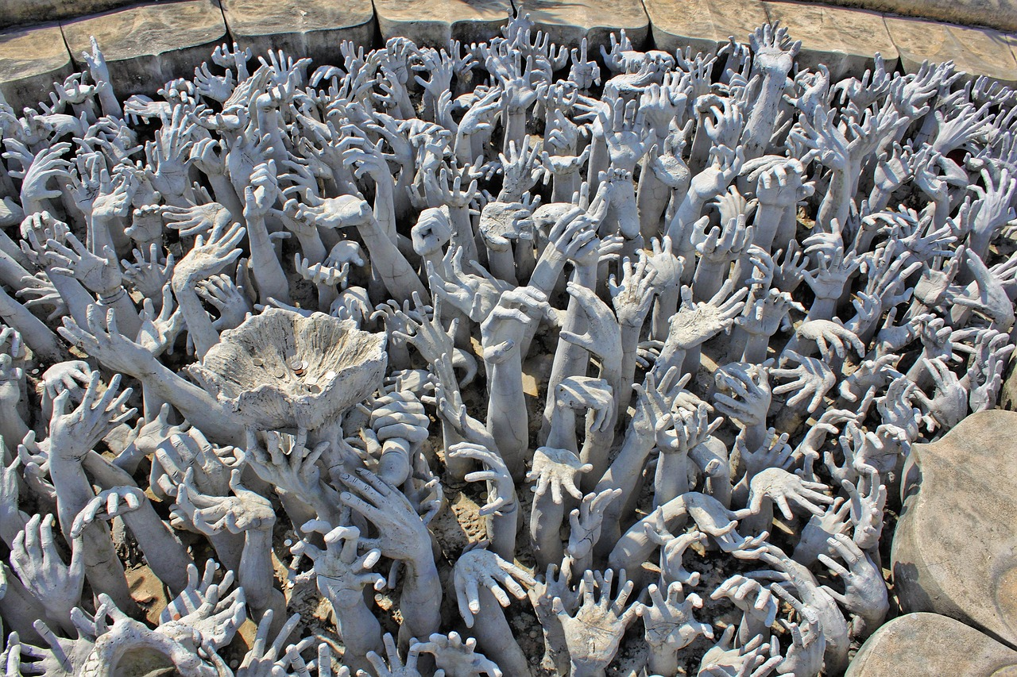
Eight billionaires have the same wealth as that of the 3.6 billion people who make up the poorest half of humanity.
An Economy For The 99%, Oxfam Report, 2017

Slide 20
INDIFFERENCE: “I DON’T CARE”
MAIN OBSTACLE TO COMPASSION
In our globalized world we have become immune to the suffering of the other/others.
In the effort to ensure our own comfort we have developed a “globalized indifference” that keeps us from suffering with others.
“Father, we ask your pardon for those who are complacent and closed amid comforts which have deadened their hearts. We beg your forgiveness for those who by their decisions on the global level have created situations that lead to these tragedies. Forgive us, Lord!” Pope Francis 07.08.13

Slide 21
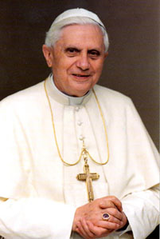
“It’s our very sleepiness to the presence of God that renders us insensitive to evil: we do not hear God because we do not want to be disturbed, and so we remain indifferent to evil. Pope Benedict XVI, April 20, 2011
Redefining “evil” as any form of violence (inflicting injury).
Understanding evil-doing as the opposite of “doing good”
Realizing that evil is sustained by indifference, i.e., “The only thing necessary for the triumph of evil is that good [wo]men to do nothing” (Edmund Burke)

Slide 22
ELI WEISEL ON “INDIFFERENCE”
The opposite of love is not hate, it's indifference. The opposite of beauty is not ugliness, it's indifference. The opposite of faith is not heresy, it's indifference. And the opposite of life is not death, but indifference between life and death.
  Elie Wiesel, US News & World Report, 27 October 1986

Slide 23
INDIFFERENCE: MAIN OBSTACLE TO COMPASSION
“Morally it makes no difference whether a person is killed in war or condemned to starve by the indifference of others:” Willy Brandt
Biblical “Hardness (Scleros) of the Heart (Kardia)”
Apathy = A-Pathos = No Feeling
Inability to “Suffer With”
Compassion Fatigue
Psychic Numbing
Routinization
Amnesia
Lack of Care

Slide 24
CARE
Correction
Challenge
Affirmation
Respect
POSITIVE WAYS OF RELATING
+ FORCE / ENERGY
Power is “the ability to influence”
POWER =
“I AM”
Thinking
Feeling
Acting
NEGATIVE WAYS OF RELATING
Power is about Relationships
- FORCE / ENERGY
Coercion
Exploitation
Manipulation
Domination
War
Don’t Care
Fear
Injury
Divorce
Apathy
CONTROL
ABUSE
DESTRUCTIVE
CONFLICT
VIOLENCE
BREAK
HATE
INDIFFERENCE
Intimidation
Walkout
Hardness of Heart
Hurt
Misunderstanding
Suffering
Strike

Slide 25
CARE: FOUNDATION OF HUMANKIND
Scientists generally acknowledge the connection between altruism and healthy self-interest (contra unhealthy self-preoccupation).
Such altruism has a genetic connection re: the survival of the species: when an organism sacrifices its life to save another, it helps perpetuate their shared genes.
Human altruism: empathy re: those in need or distress.
Women tend to be more empathetic because it is trig-gered by oxytocin, a hormone (birth and breast-feeding)
Both women and men evidence greater empathy when oxytocin is administered to them.
“Neighbor Love:” Moving from “our kind” to humankind.

Slide 26
Freedom
HEALING
CARE
Trust
Healthy
Correction
Challenge
Affirmation
Respect
POSITIVE WAYS OF RELATING
+ FORCE / ENERGY
Power is “the ability to influence”
Zeal / Passion
POWER =
“I AM”
Thinking
Feeling
ANGER
Acting
NEGATIVE WAYS OF RELATING
Power is about Relationships
Rage / Resentment
- FORCE / ENERGY
Coercion
Exploitation
Manipulation
Domination
War
Don’t Care
Fear
Injury
Divorce
Apathy
CONTROL
ABUSE
DESTRUCTIVE
CONFLICT
VIOLENCE
BREAK
HATE
INDIFFERENCE
Intimidation
Walkout
Hardness of Heart
Hurt
Misunderstanding
Suffering
Strike

Slide 27
Freedom
Understanding
HEALING
CONSTRUCTIVE
COLLABORATION
CARE
Trust
Healthy
Correction
Challenge
Affirmation
Respect
POSITIVE WAYS OF RELATING
+ FORCE / ENERGY
Power is “the ability to influence”
Zeal / Passion
POWER =
“I AM”
Thinking
Feeling
ANGER
Acting
NEGATIVE WAYS OF RELATING
Power is about Relationships
Rage / Resentment
- FORCE / ENERGY
Coercion
Exploitation
Manipulation
Domination
War
Don’t Care
Fear
Injury
Divorce
Apathy
CONTROL
ABUSE
DESTRUCTIVE
CONFLICT
VIOLENCE
BREAK
HATE
INDIFFERENCE
Intimidation
Walkout
Hardness of Heart
Hurt
Misunderstanding
Suffering
Strike

Slide 28
Freedom
Understanding
Gentle
HEALING
CONSTRUCTIVE
COLLABORATION
NON-VIOLENCE
CARE
Trust
Healthy
Correction
Non-hurtful
Challenge
Affirmation
Respect
POSITIVE WAYS OF RELATING
+ FORCE / ENERGY
Power is “the ability to influence”
Zeal / Passion
POWER =
“I AM”
Thinking
Feeling
ANGER
Acting
NEGATIVE WAYS OF RELATING
Power is about Relationships
Rage / Resentment
- FORCE / ENERGY
Coercion
Exploitation
Manipulation
Domination
War
Don’t Care
Fear
Injury
Divorce
Apathy
CONTROL
ABUSE
DESTRUCTIVE
CONFLICT
VIOLENCE
BREAK
HATE
INDIFFERENCE
Intimidation
Walkout
Hardness of Heart
Hurt
Misunderstanding
Suffering
Strike
© Michael H. Crosby 2009

Slide 29
Freedom
Understanding
Gentle
HEALING
CONSTRUCTIVE
COLLABORATION
NON-VIOLENCE
PEACE
LOVE
COMPASSION
CARE
Trust
Healthy
Correction
Non-hurtful
Challenge
Affirmation
Respect
POSITIVE WAYS OF RELATING
+ FORCE / ENERGY
Power is “the ability to influence”
Zeal / Passion
POWER =
“I AM”
Thinking
Feeling
ANGER
Acting
NEGATIVE WAYS OF RELATING
Power is about Relationships
Rage / Resentment
- FORCE / ENERGY
Coercion
Exploitation
Manipulation
Domination
War
Don’t Care
Fear
Injury
Divorce
Apathy
CONTROL
ABUSE
DESTRUCTIVE
CONFLICT
VIOLENCE
BREAK
HATE
INDIFFERENCE
Intimidation
Walkout
Hardness of Heart
Hurt
Misunderstanding
Suffering
Strike
© Michael H. Crosby 2009

Slide 30
“Some people assume that economic growth, encouraged by a free market, will inevitably bring about greater justice and inclusiveness in the world. This opinion, which has never been confirmed by the facts, expresses a naïve trust in the goodness of those wielding economic power and in the sacralized workings of the prevailing economic system. Meanwhile, the excluded are still waiting. To sustain a lifestyle which excludes others a globalization of indifference has developed. Almost without being aware of it, we end up being incapable of feeling compassion at the outcry of the poor, weeping for other people’s pain, and feeling a need to help them, as though all this were someone else’s responsibility and not our own. The culture of prosperity deadens us; we are thrilled if the market offers us something new to purchase. In the meantime all those lives stunted for lack of opportunity seem a mere spectacle; they fail to move us.” Pope Francis, Evangelii Gaudium, 54.

Slide 31
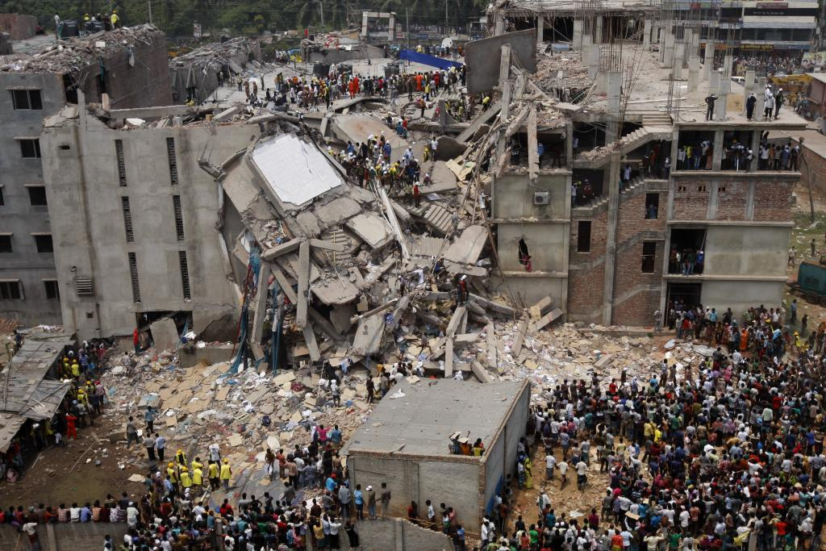
RANA PLAZA COLLAPSE, MAY 22, 2013

Slide 32
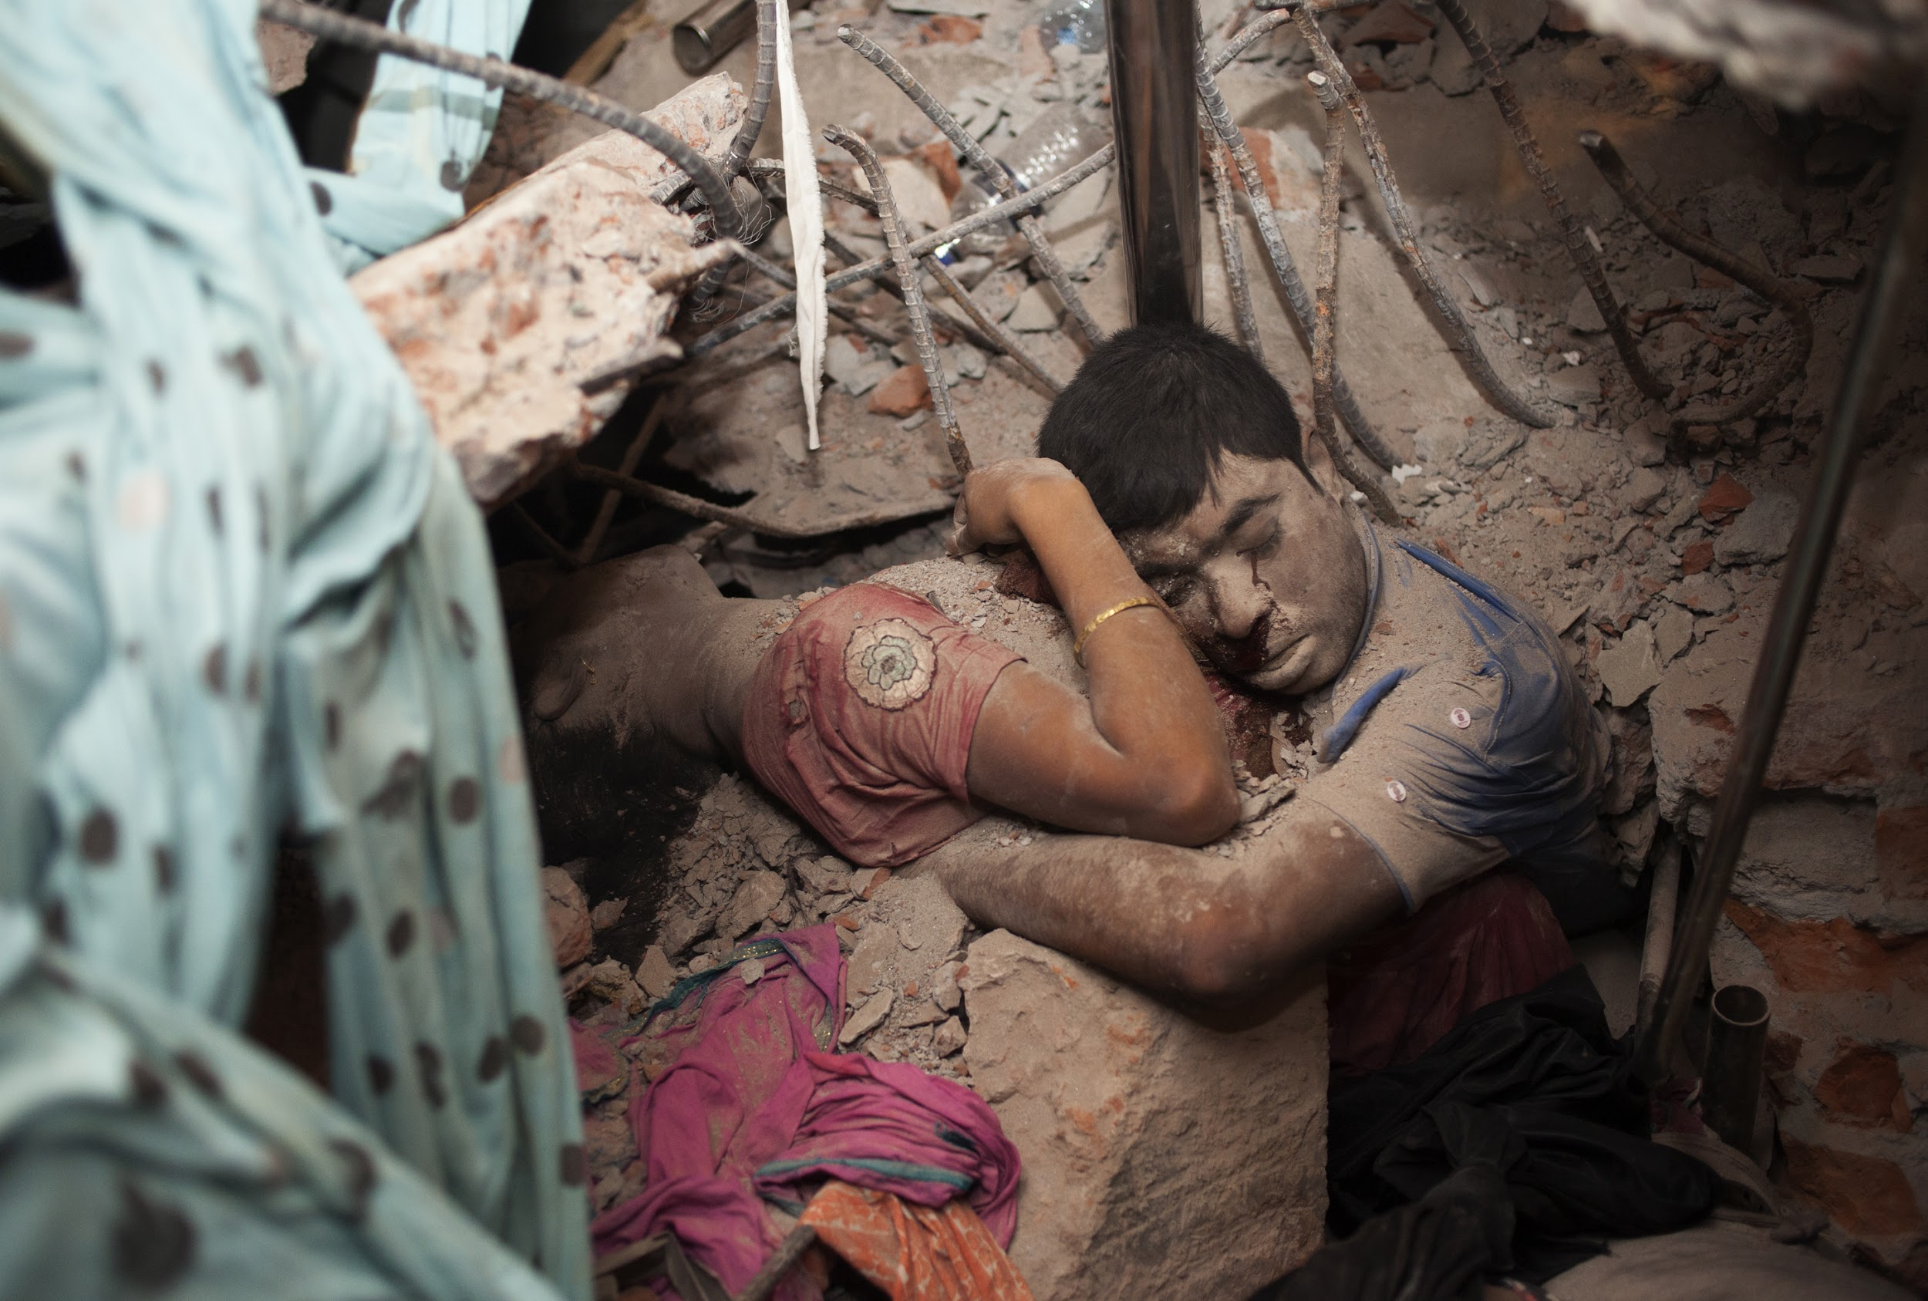
1,129 human beings who worked at Rana Plaza died that day, leaving behind their families and loved ones.

Slide 33
HUMAN TRAFFICKING
Definition: The act of recruiting, harboring, transporting, providing or obtaining a person for compelled labor or commercial sex through force, fraud or coercion. Movement not required; can happen “in town”
Layers of Exploitation: Sexual exploitation and forced labor most common forms. Other under-reported forms of exploitation: domestic servitude, forced marriage, organ removal, exploiting children to beg.
Causes of trafficking: Complex, interlinked causes: economic, social and political factors, not only poverty, but corruption, civil unrest, a weak government, lack of access to education or jobs, family disruption or dysfunction, lack of human rights, or economic disruptions.
Profit over People: A report from the ILO says forced labor generates $150 billion in illegal profits per year.
Nowhere on the planet is free of trafficking.
Migrants Benefitting Corporations: Syrian refugees working in Turkish garment factories. Editorial, The New York Times, 03.20.17.

Slide 34
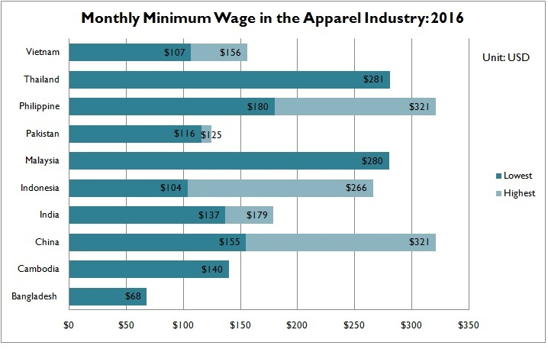

Slide 35
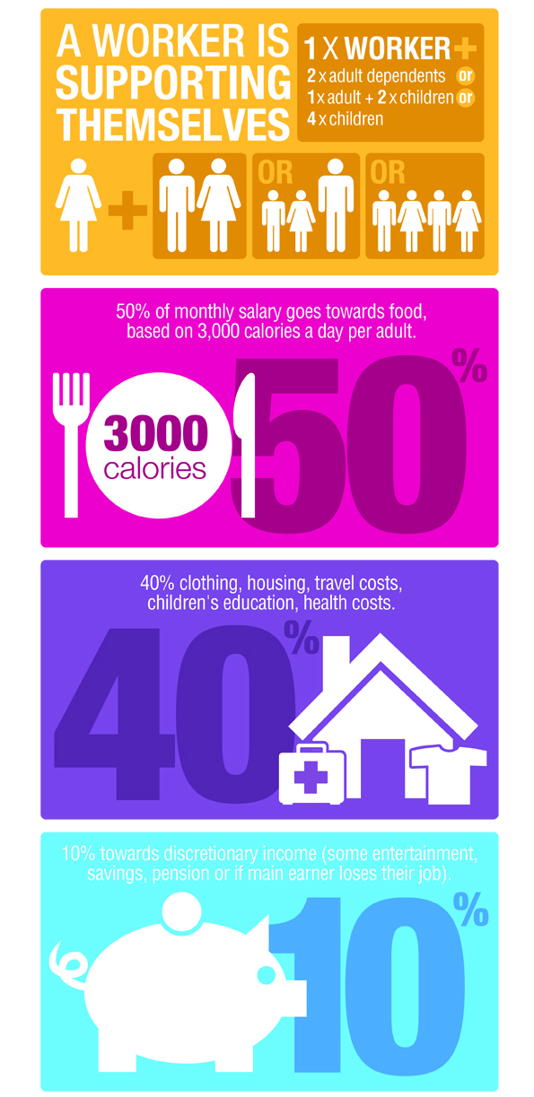
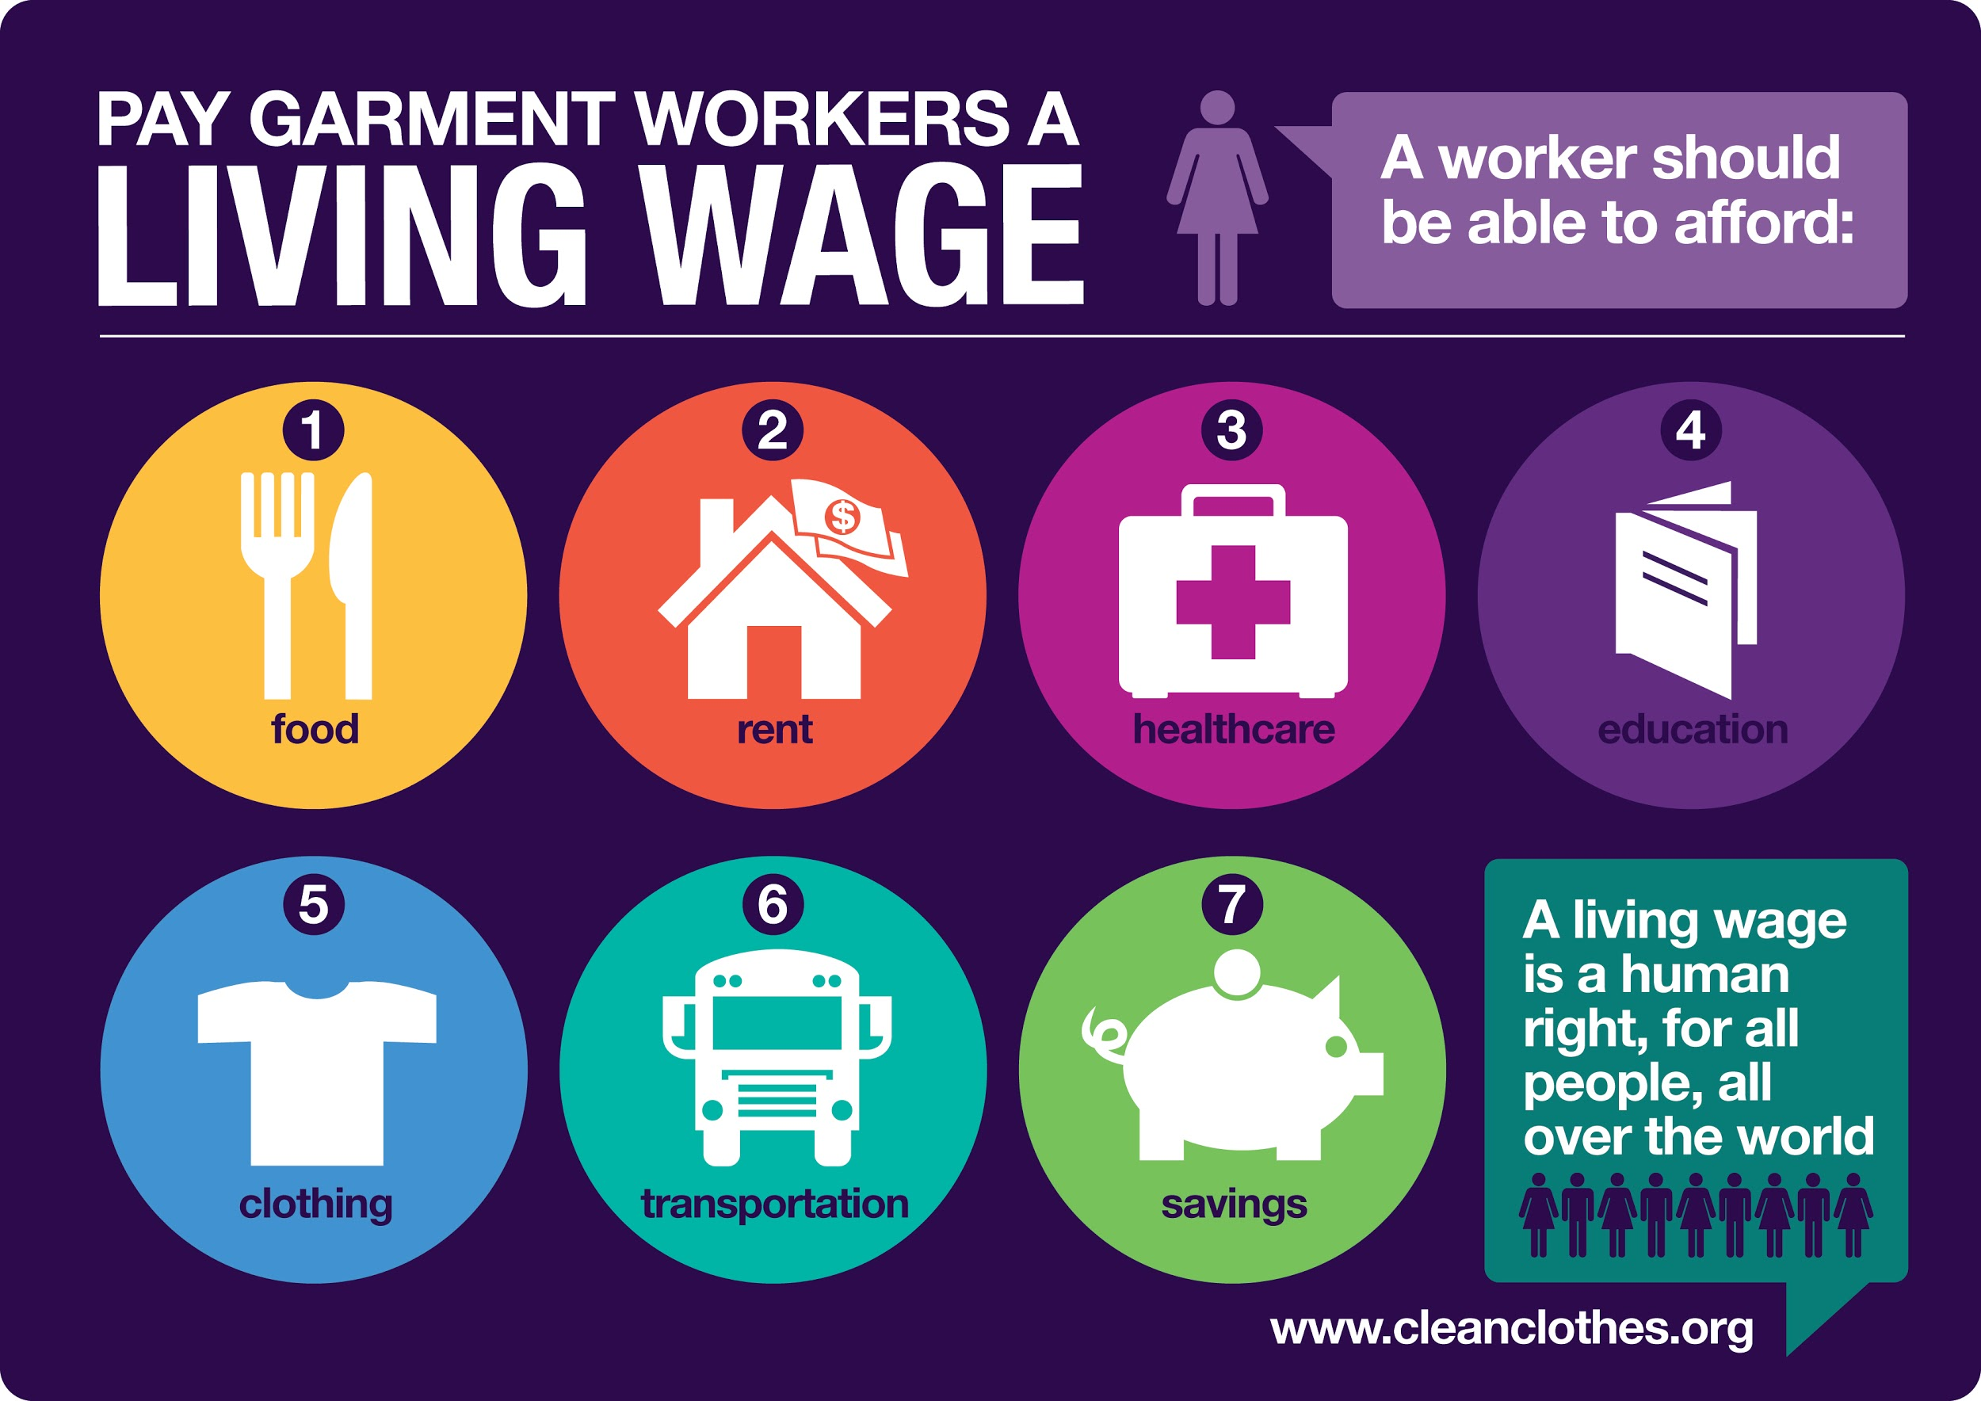
POVERTY/ LIVING WAGE

Slide 36
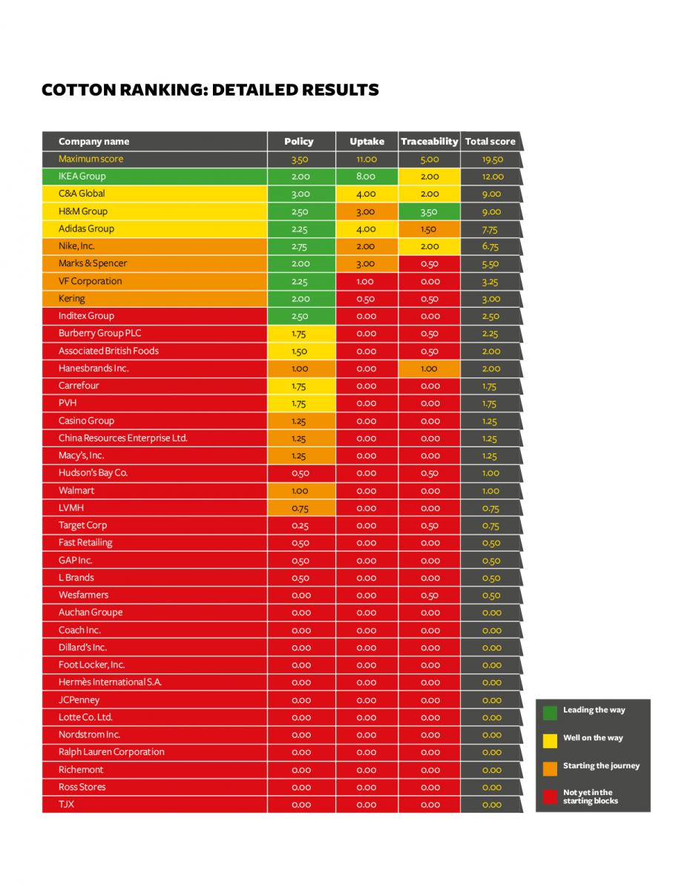

Slide 37
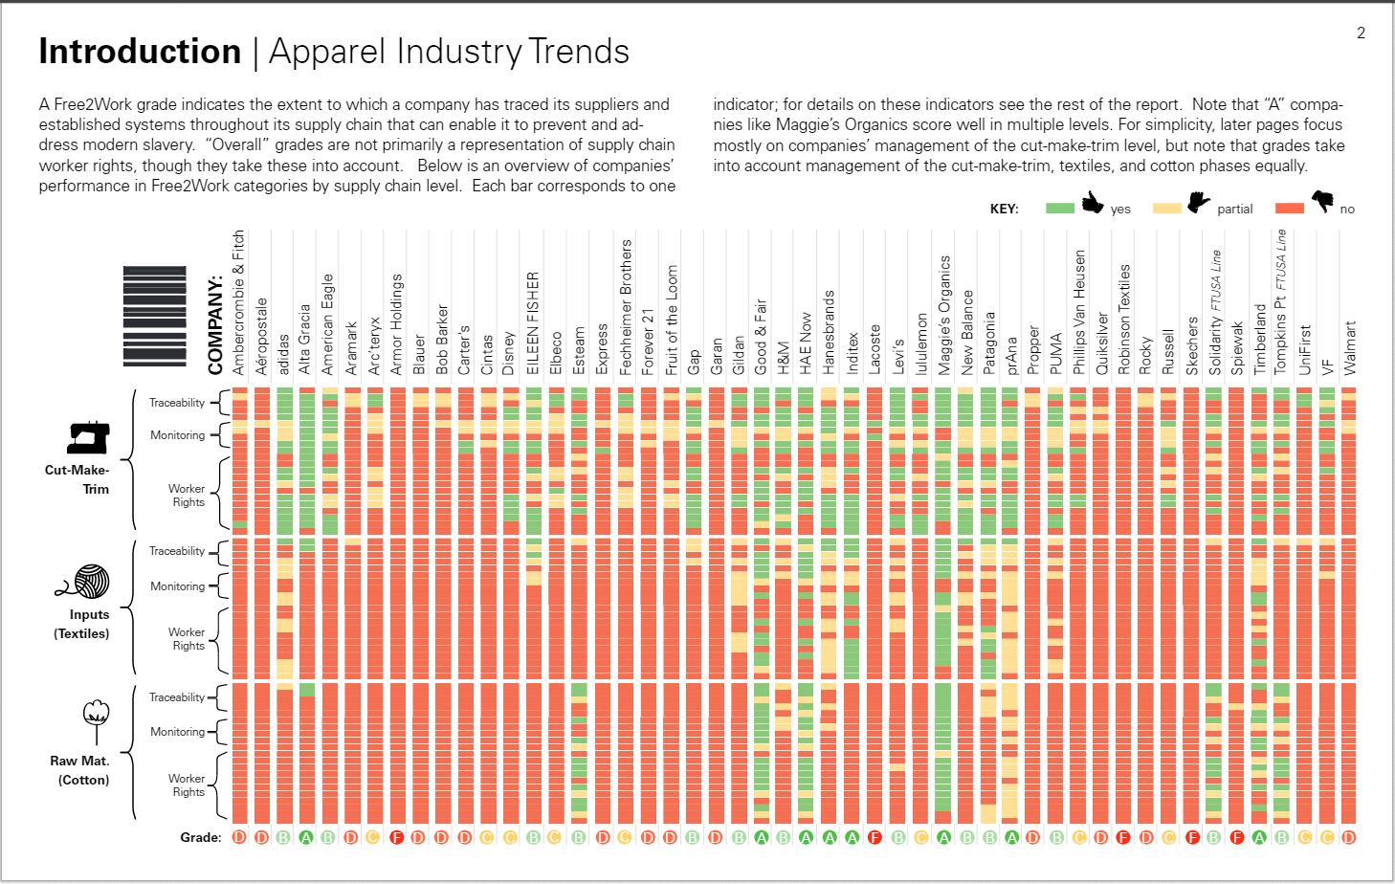

Slide 38

THE GLOBALIZATION/LOCALIZATION OF INDIFFERENCE

Slide 39
INDIFFERENCE: RESULT OF PRIVILEGE
“Where I stand is how I see.” Privilege: a right, form of access, advantage or immunity experience by or granted to one group of people without being extended to others.
Think of where you stand from a position (and, therefore, [un]conscious perspective) of privilege (= an unearned access for self that is denied others).
How does this impact/influence/have power over the way you see those who are not standing “with you”?
The inability to act against the oppression from which one derives his/her power, privilege and acceptance.
Impasse: The ([un]conscious) way(s) we fail to acknowledge the psychological, affective and emotional toll/costs dimensions of a situation.

Slide 40
WHAT CAN I/WE DO?
Make a Journey from Indifference to Compassion
Unaware
Aware
Categorized
Have an opinion
Experienced
Have a new opinion
Share that opinion in a way that reinforces it and locks it in
(Courtesy of Seth Godin)
Notes:
It's pretty clear that most the world is unaware of you and your work.
Once someone becomes aware of it, they'll probably leave it at that. "Oh." Because we're busy. And afraid of the new, because it often causes us to change our minds, which is frightening and difficult.
But sometimes, the culture or our work gives us no choice but to engage. We begin by putting this new thing into a category, so we know what to do with it, how to store the concept. Often, that's immediately followed by forming an opinion.
It's a huge leap, then, to go from, "Yuck, they make protein bars out of crickets," to, "I am going to try one."
After an experience, it's possible for a new opinion to be formed. But we like to be right, so that first opinion often sticks around.
And finally, seven steps in, it's possible that the word will spread, that awareness will be shared, that we'll tell someone else. And so the awareness barrier is crossed again, and the idea spreads, and opinions are truly locked in.
Some of these stages happen in clumps. Sometimes they take months or years to occur. How much time passed between the day you became aware that hockey was a spectator sport and the first time you went to a game?
We benefit when we're aware of how our idea will work its way through all seven stages, and cognizant that the process is different depending on the category, the culture and the people we're engaging with. Do it on purpose.

Slide 41

WHAT CAN I/WE DO?
I/We Pledge to:
PRAY to cultivate solidarity between us consumers of clothing with the people who produce them for a more just economy.
LEARN about/educate others on the real consequences (both negative and positive) of globalized supply chains, especially in the clothing industry.
ASSESS how we can confront the “globalization of indifference” in the clothing industry by showing greater compassion and responsibility for the unintended consequences of our behavior as consumers.
ACT to change our consumer choices/behaviors to improve the lives people who make our clothing and other consumer goods in the global economy.
ADVOCATE for Catholic principles and priorities with retailers, brand owners and government bodies about their wages and working conditions.

Slide 42
WHAT CAN I/WE DO?
REDUCE: Most closets often are too small to hold our stuff, regardless of their size. Ask: “Does this purchase make my life better? Does it make another’s life better?”
REPAIR: Learning to sew.
REUSE: via St. Vincent de Paul, Goodwill, or the Salvation Army.
RECYCLE: So that our clothes live long, useful lives and never end up in a landfill.

Slide 43
JESUS’ TEACHING IN LUKE’S GOSPEL RE:
COMPASSION TOWARD THE ESTRANGED
The Parable of the Good Samaritan: Jesus’ response to the query: “Who is my neighbor?”
The culturally received notions about “reciprocity” toward one’s own, one’s kin and one’s enemy that colored the worldview of the religious leader questioning Jesus.
Why did the Priest and Levite “see him” and “pass by” [i.e. not be moved by compassion to act]?
“Compassion is not comfortable and private but rather dangerous and political.” Maureen H. O’Connell, 3

Slide 44
OUR LIFESTYLE/CONSUMERISM (The New Religion) CONTINUES BY THE EXPLOITATION OF OUR NEIGHBORS WHO CLOTHE US AND THE PLANET WHICH HOUSES US
TRYING TO MAKE A DIFFERENCE THRU OUR EFFORT TO “CLOTHE OUR NEIGHBOR AS OURSELVES”
The Planetary Crisis
Who Is Clothing Us?
“Religions are being asked to take on . . . the heart of their own message: ‘a wholesale transformation of dominant cultural patterns,’ particularly at the level of consumerism” through restraint. Sally McFague, Blessed Are the Consumers: Climate Change and the Practice of Restraint, 2013
The Human Thread: Catholics for Clothing with a Conscience aims to inspire Catholics in parishes, schools and colleges/universities to connect the “cost” of their clothing choices in light of the wages paid to those human beings who produce them.

Slide 45
MOVING TO COMPASSION
Our task must be to free ourselves from the prison [of thinking we are separated from others] by widening our circle of compassion to embrace all living creatures and the whole of nature in its beauty. We shall require a substantially new manner of think-ing if humankind is to survive.
Albert Einstein, February 12, 1950

Slide 46
THE CALL IS CLEAR AND SIMPLE
The Church’s One Foundation
The call is clear and simple: “Love God and humankind,”
but love demands much wisdom and clarity of mind.
“Be wily as a serpent, though gentle as a dove,”
For many are the dangers upon the path of love.
God, help us sort our motives, that loving may be whole.
High aims or base ambition? Compassion or control?
Then help us clear our schedules of ev’ry frantic task
that leads away from doing the one thing that you ask.

Slide 47


HOW TO CONTACT US
www.humanthreadcampaign.org
@ClothConscience
www.facebook.com/HumanThreadCatholicsforClothingwithaConscience

